Slide 1
Sequence Diagram VS Use Case Diagram

Slide 2
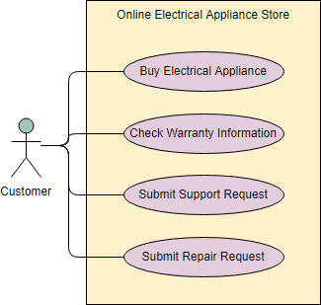
Use case Diagram
A use case describes how a user uses a system to accomplish a particular goal.
A use case diagram consists of the system, the related use cases and actors and relates these to each other to visualize: what is being described? (system), who is using the system? (actors) and what do the actors want to achieve? (use cases),
thus, use cases help ensure that the correct system is developed by capturing the requirements from the user's point of view.

Slide 3
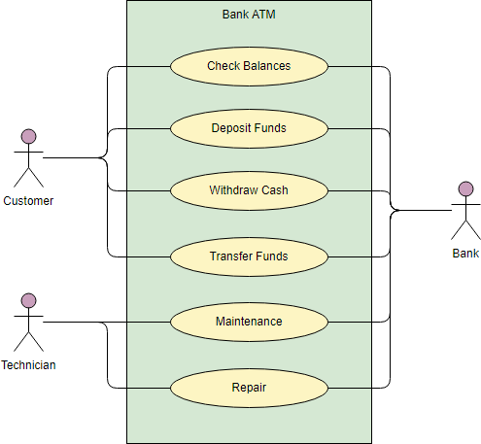
Use Case Diagram Notations
Actor
Actors are usually individuals involved with the system defined according to their roles.
The actor can be a human or other external system.
Use Case
A use case describes how actors uses a system to accomplish a particular goal.
Use cases are typically initiated by a user to fulfil goals describing the activities and variants involved in attaining the goal.
Relationship
The relationships between and among the actors and the use cases.
System Boundary
The system boundary defines the system of interest in relation to
the world around it.

Slide 4
How to Draw a Use Case Diagram?
A Use Case model can be developed by following the steps below:
Identify the Actors (role of users) of the system.
For each category of users, identify all roles played by the users relevant to the system.
Identify what are the users required the system to be performed to achieve these goals.
Create use cases for every goal.

Slide 5
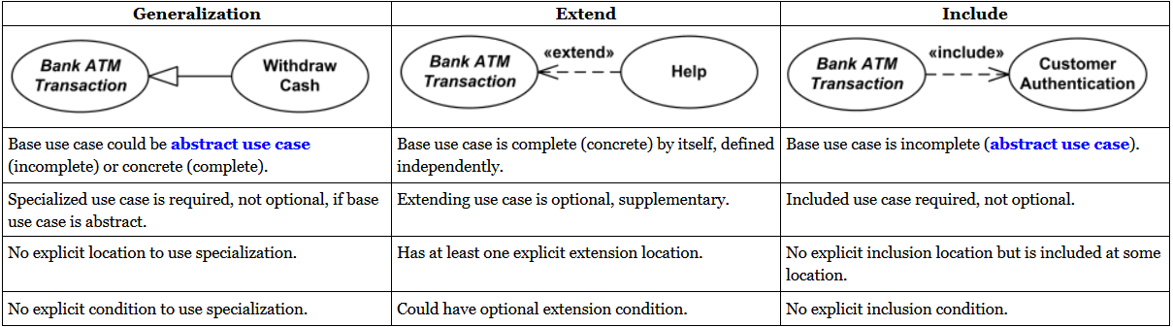
Relationships

Slide 6
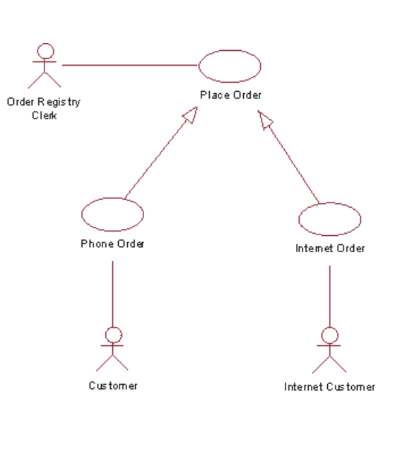
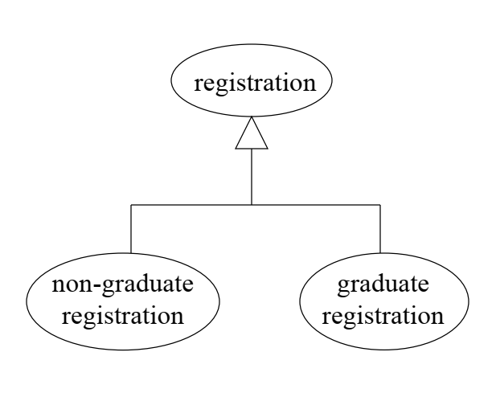
Generalization Example
Notes:
Generalization relationships (Basic Inheritance)
In UML modeling, a generalization relationship is a relationship in which one model element (the child) is based on another model element (the parent). Generalization relationships are used in class, component, deployment, and use-case diagrams to indicate that the child receives all of the attributes, operations, and relationships that are defined in the parent.

Slide 7
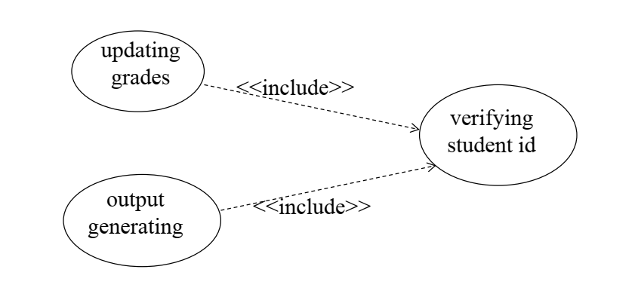
Include Example
Notes:
Include is used to extract use case fragments that are duplicated in multiple use cases. The included use case cannot stand alone and the original use case is not complete without the included one. This should be used sparingly and only in cases where the duplication is significant and exists by design (rather than by coincidence).
For example, the flow of events that occurs at the beginning of every ATM use case (when the user puts in their ATM card, enters their PIN, and is shown the main menu) would be a good candidate for an include

Slide 8
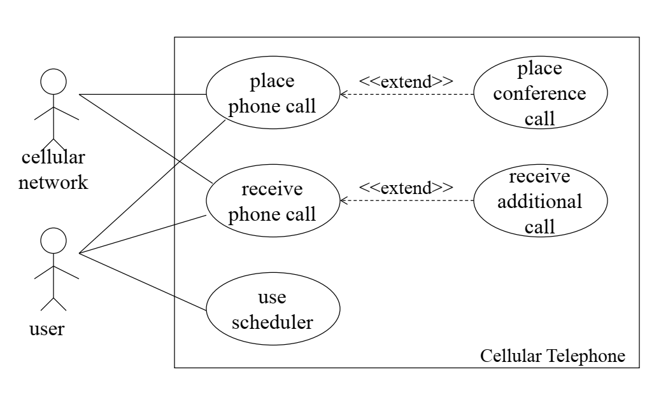
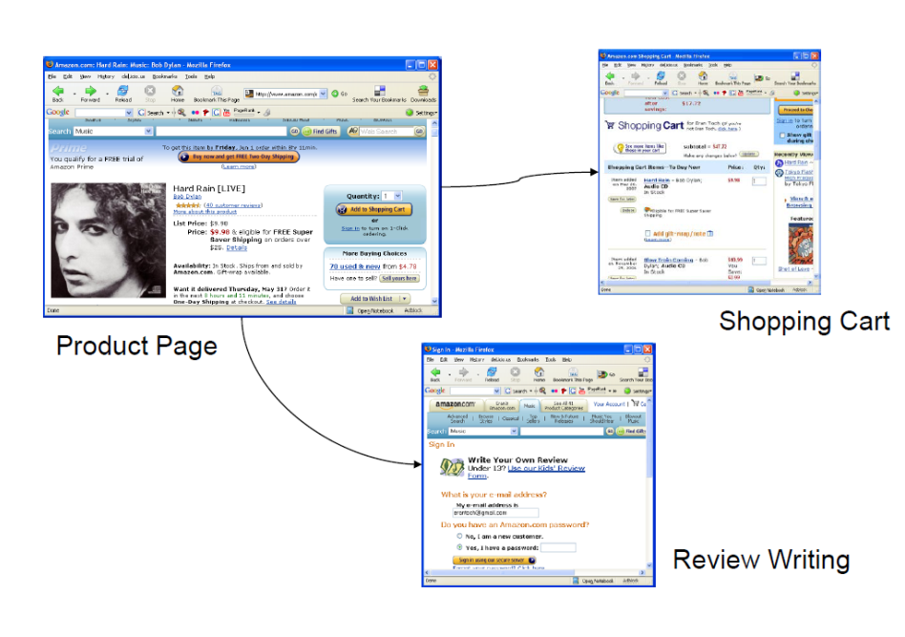
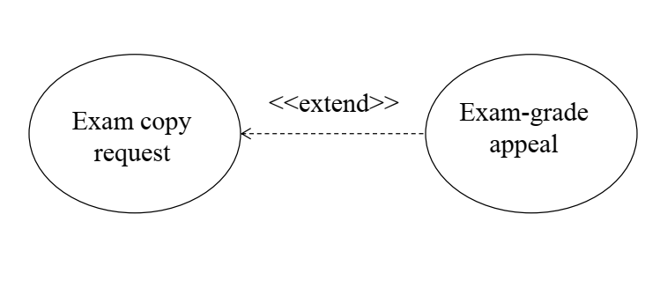
Extend Example
Notes:
Extend is used when a use case adds steps to another first-class use case.
For example, imagine "Withdraw Cash" is a use case of an Automated Teller Machine (ATM). "Assess Fee" would extend Withdraw Cash and describe the conditional "extension point" that is instantiated when the ATM user doesn't bank at the ATM's owning institution. Notice that the basic "Withdraw Cash" use case stands on its own, without the extension.

Slide 9
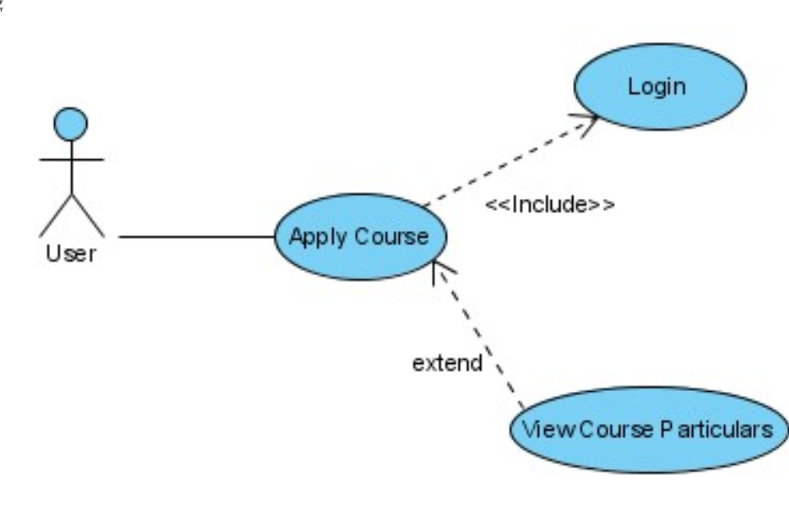
Include Vs Extend

Slide 10
Extend vs. Include
Wheels
Car
DVD players
Notes:
Car includes Wheels and extends DVD players
10

Slide 11
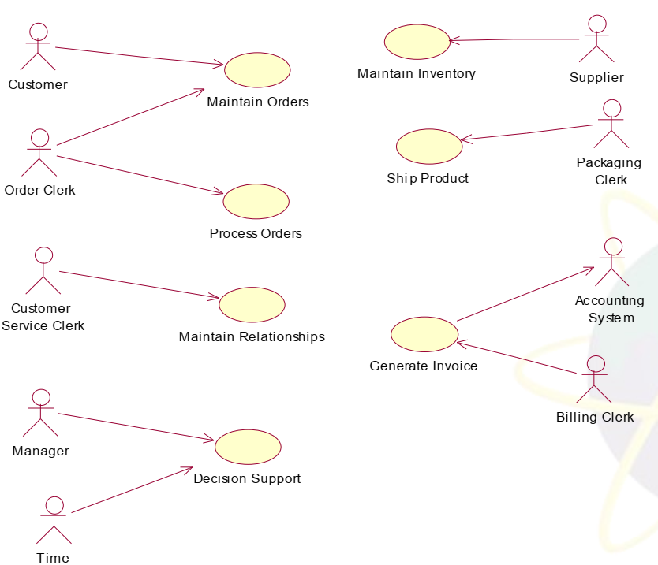
Which is valid and which isn’t ?

Slide 12
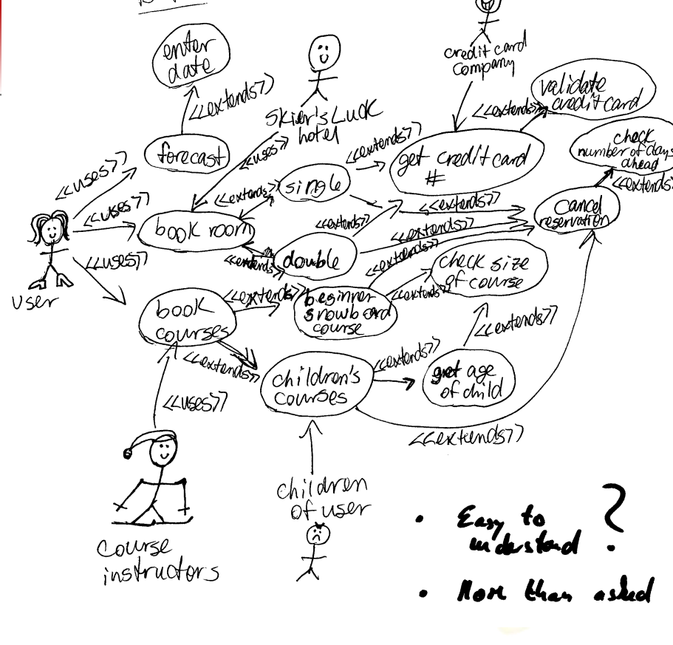
Use Case Mistakes

Slide 13
Examples

Slide 14
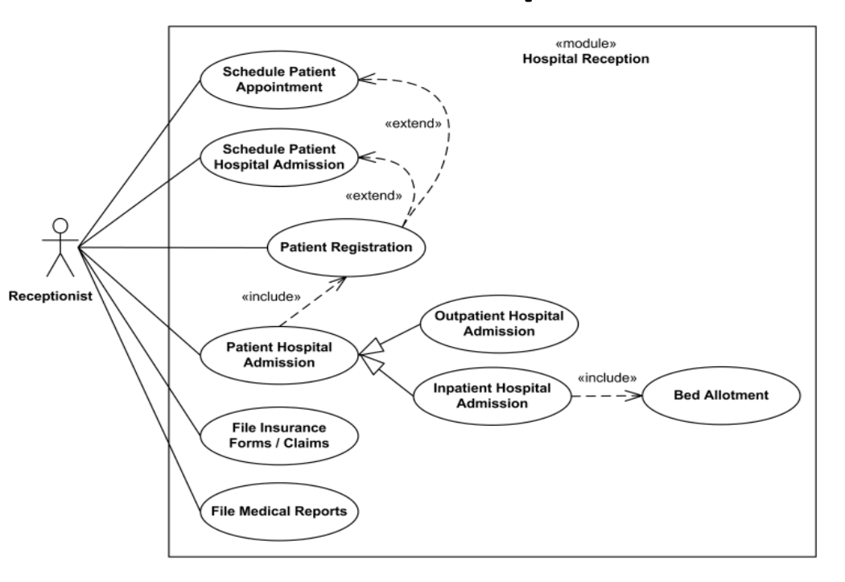
Ex(1)

Slide 15
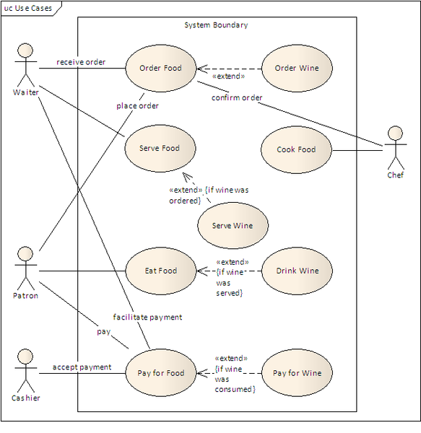
EX(2)
Notes:
Consider the "Order Wine" and "Serve Wine" use cases. The "Order Wine" extends the "Order Food", meaning that wine may be ordered by the customer, but not necessarily (optional).

Slide 16
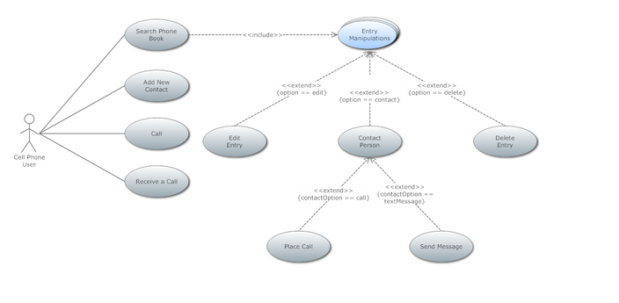
Ex(3)
Use Case Diagram to draw Phone Book that you can easily edit and customize in minutes.

Slide 17
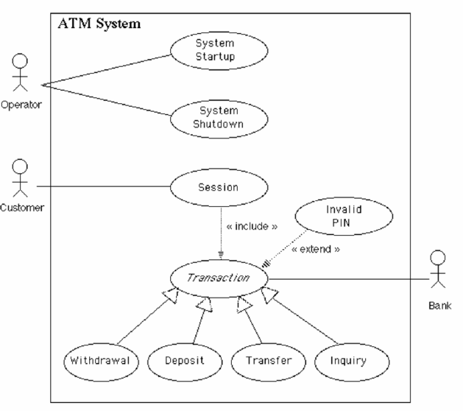
Ex(4)

Slide 18
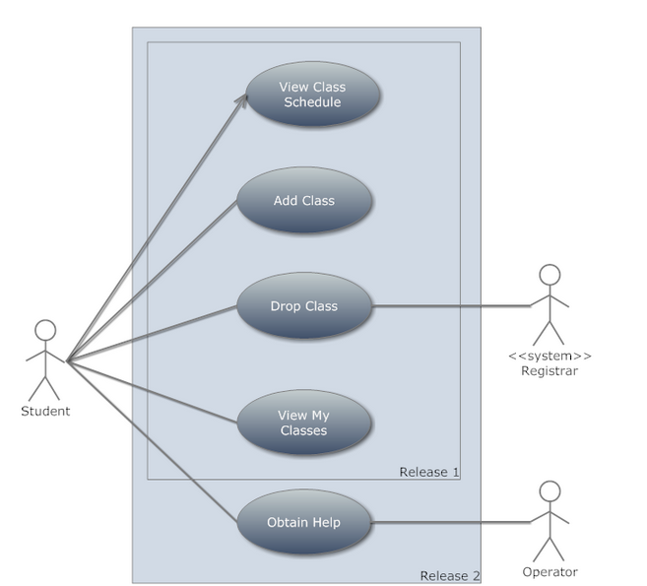
Ex(5)
Make a use Case diagram where the student can view his class schedule.
The student can also add class or drop class but the dropping has to be recorded on the registration system, the student should be also able to view his classes and obtain help.
the help will be given by the help operator

Slide 19
Ex(6)
Altered State University (ASU) Registration System 1. Professors indicate which courses they will teach on-line. 2. A course catalog can be printed 3. Allow students to select on-line four courses for upcoming semester. 4. No course may have more than 10 students or less than 3 students. 5. When the registration is completed, the system sends information to the billing system. 6. Professors can obtain course rosters on-line. 7. Students can add or drop classes on-line.

Slide 20
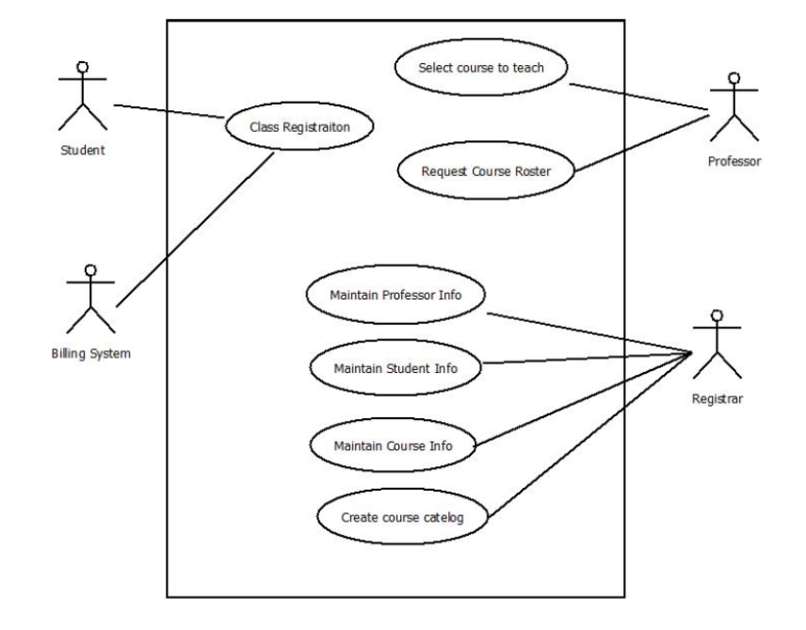
Ex(6)

Slide 21
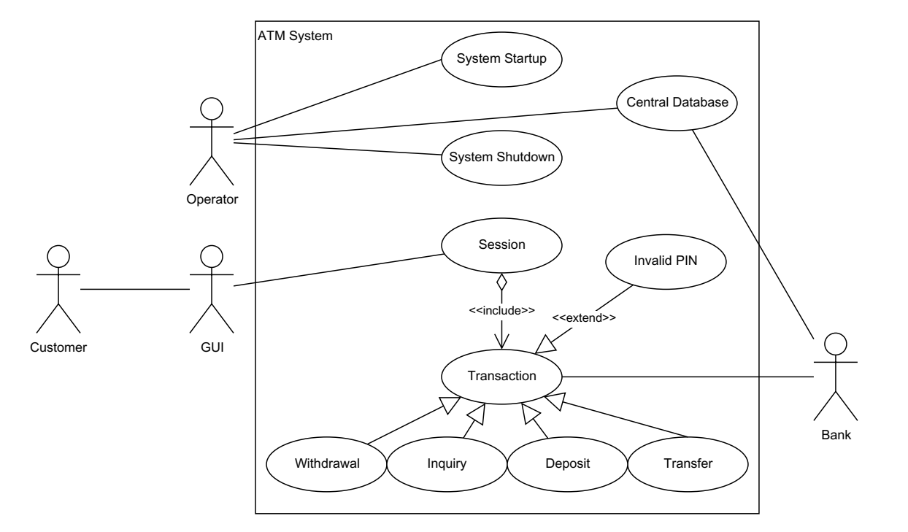
Ex(7)

Slide 22
Ex(7)
According to the diagram, Transaction is an abstract superclass for Withdrawal, Inquiry, Deposit, Transfer and Invalid PIN.
The relation between Invalid PIN and Transaction does not conform to the UML standard.
The use case should clarify in what direction data is transferred to and from the Central Database.
The Central Database should be moved outside the ATM System box, but the connections should be kept.
The relation between the Customer and the GUI is not permitted in UML use case diagram syntax.
The relations connecting the Operator, GUI and Bank to the ATM System are missing the arrows.
Notes:
Wrong
Right
Wrong
Wrong
Right
Wrong

Slide 23
Ex(8)
All Users must first enrol with the System before they have the right to use the system 1. User enrols with System, providing System with registration information.
Steps 2-5 can be repeated many times.
2. User identifies him/herself to System. 3. System presents Customer with a welcome message.
The user-goal level use cases of step 4 can be performed in parallel and individually repeated. A customer may bid and sell in many auctions at any one time.
4. Customer increases credit with System ! or Customer buys an item on auction ! or Customer sells an item by auction 5. Customer exits System. 6. Customer requests to cancel his/her enrollment.

Slide 24
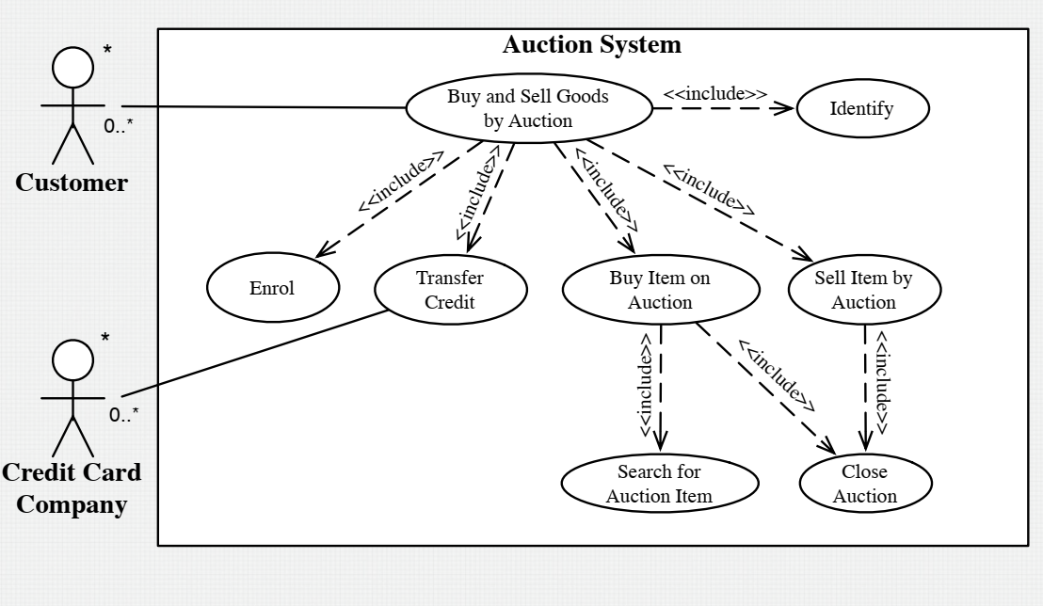
Ex(8)

Slide 25
Ex(9) : Inventory System
In order to generate an invoice a clerk must log in. If a clerk is a first time user, one must have themselves registered.
There should be an option for a user to register oneself within the login page. Any user can use the system to view products online.
The option of login is also provided when a user views products online.

Slide 26
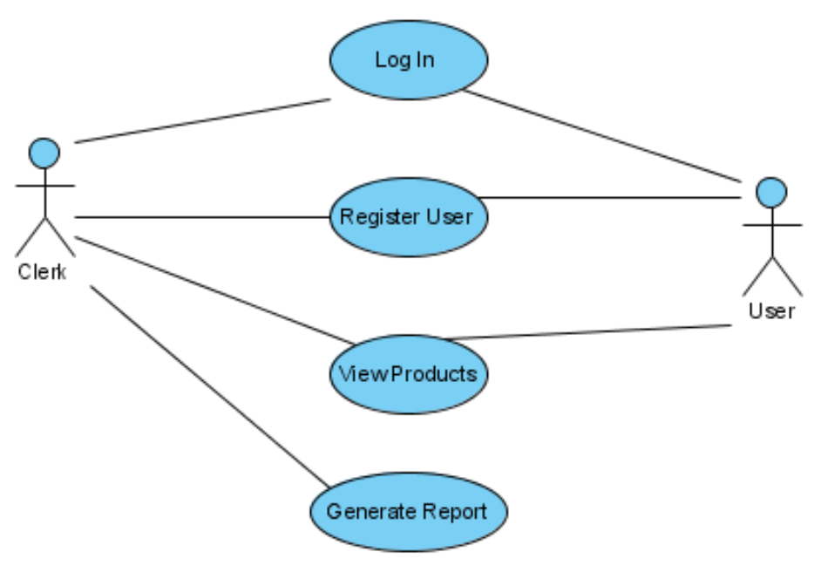
Ex(9)

Slide 27
Sequence Diagram

Slide 28
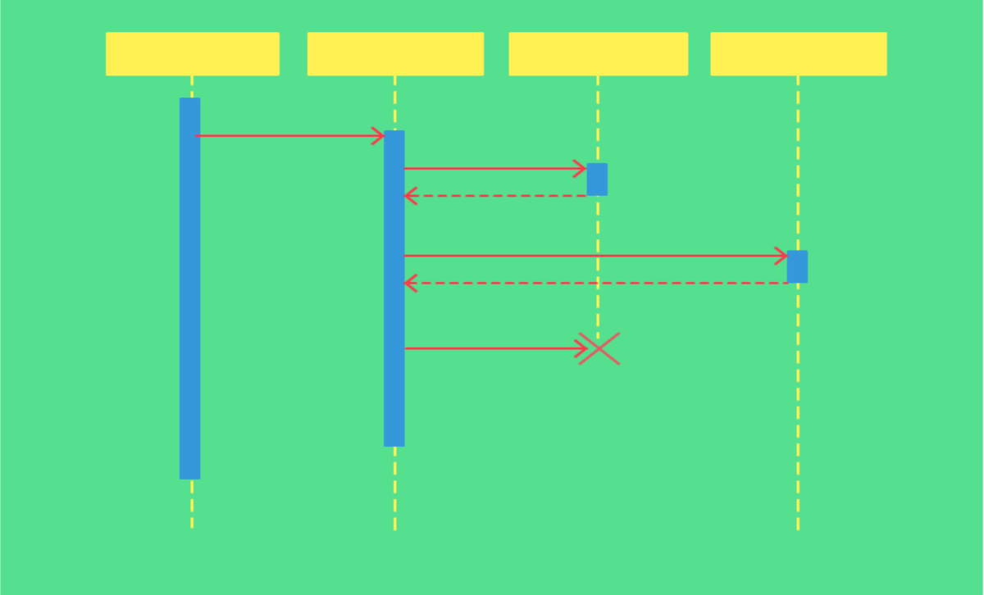
Sequence diagram
UML Sequence diagrams are interaction diagrams that detail how operations are carried out.
Sequence diagrams are time focus and they show the order of the interaction visually by using the vertical axis of the diagram to represent time what messages are sent and when.
In simpler words, a sequence diagram shows different parts of a system work in a ‘sequence’ to get something done.
A sequence diagram represents the scenario or flow of events in one single use case.
The message flow of the sequence diagram is
based on the narrative of the particular use case.

Slide 29
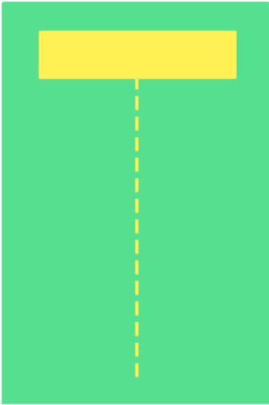
Sequence Diagram Notations
1) Lifeline
A sequence diagram is made up of several of these lifeline notations
They should be arranged horizontally across the top of the diagram
No two lifeline notations should overlap each other
They represent the different objects that interact with each other in the system

Slide 30
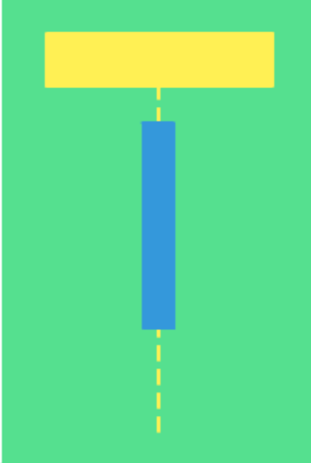
Sequence Diagram Notations
2) Activation Bars
Activation bar is the box placed on the lifeline
It indicates that an object is active ((or instantiated) during an interaction between two objects
The length of the rectangle indicates the duration of the interaction

Slide 31
Sequence Diagram Notations
3) Message Arrows
An arrow from the Message Caller to the Message Receiver specifies a message
The message can flow in any direction; from left to right, right to left and back to the caller itself
The description of the message should go on the arrow
Arrow heads may change according to different message types

Slide 32


Sequence Diagram Notations
3) Message Arrows
Call Message
A call message defines a particular communication between lifelines of an interaction, which represents an invocation of operation of target lifeline.
Return Message
A return message defines a particular communication between lifelines of an interaction, which represents the pass of information back to the caller of a corresponded former message.

Slide 33
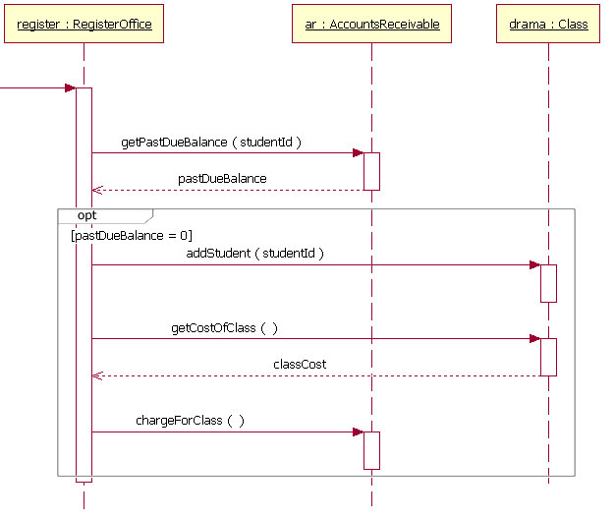
Option

Slide 34
Examples

Slide 35
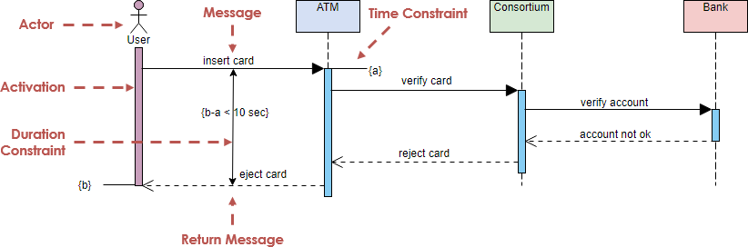
Ex(1)

Slide 36
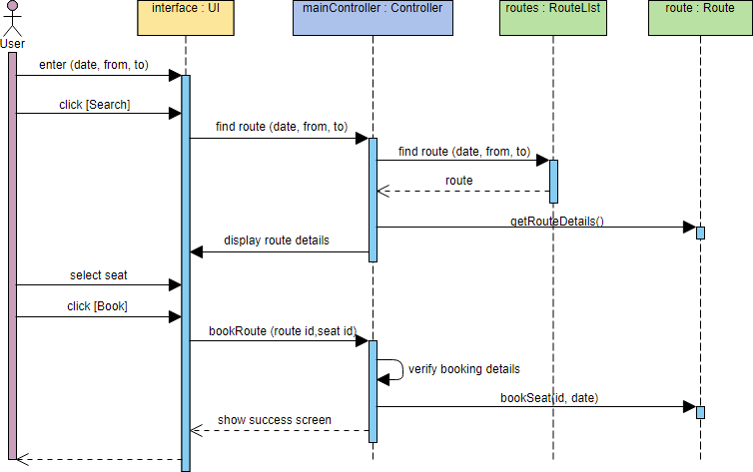
Ex(2)
The sequence diagram example below shows the interactions between a user and a ticket booking system in booking a seat. It consists of mainly four parts: The actor, which is the user, the boundary object ‘interface', the controller object ‘mainController' and two entity objects routes and route.

Slide 37
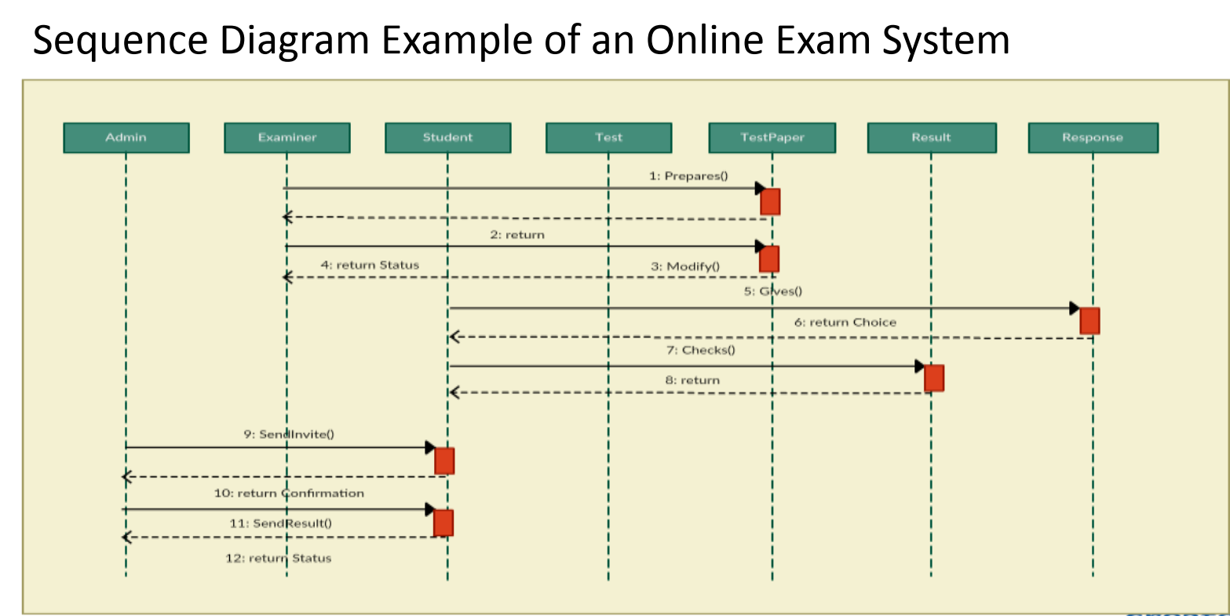
Ex(2)

Slide 38
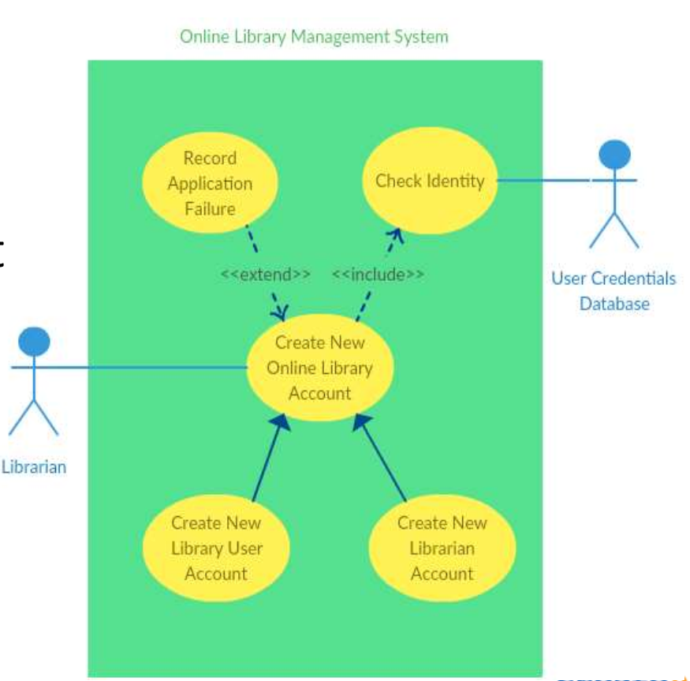
EX(3)
Create new online library account

Slide 39
Ex(3)
Step 1 Identify the objects or participants in the use case ‘Create New User Account’ • Librarian • Online Library Management system • User credentials data base • Email system

Slide 40
Ex(3)
List down the steps involved in the execution of the use case
• The librarian requires the system to create a new online library account • The librarian selects the library user account type • The librarian enters the user’s details • The user’s details are checked using the user Credentials Database • The new library user account is created • A summary of the new account’s details is emailed to the user

Slide 41
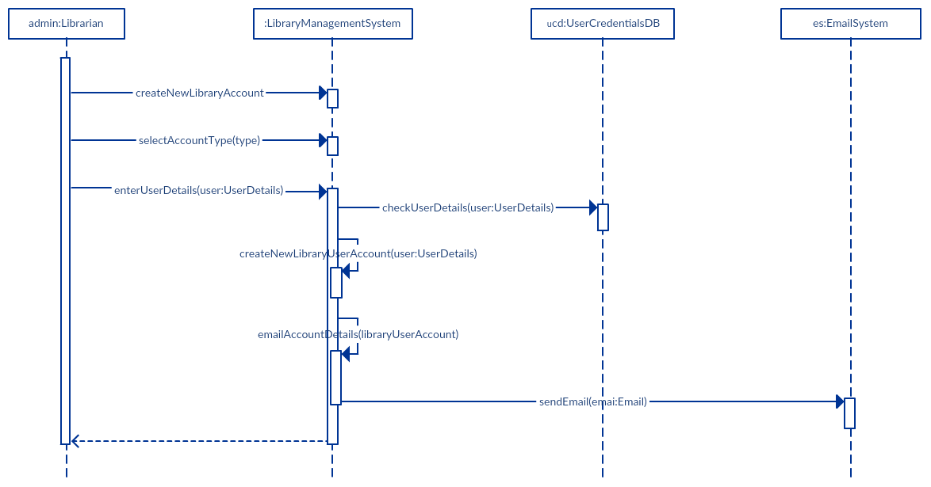
Ex(3)

Slide 42
THE END ☺

